Slide 1
Trees
Chapter 4

Slide 2
Assignment- Program 2
Fill in the functions
Use recursion
Don’t need to include anything
I provided sample output so you know if things are functioning properly

Slide 3
Quiz
Complexity
O(n) means it will happen n times
Classic example is a for loop
AVL
REMEMBER, it must be balanced and follow binary search properties

Slide 4
Things to work on
Talk about homework more
A bit more humor
More code
Do it immediately following the examples
Do it in an IDE
Force everyone to participate, not just some
Everyone, not just some – call on specific people
Have a student/group work out an example
More at your seat problems
Post slide ahead of time
Reference where things are in the book

Slide 5
Review
Trees (4.1)
Binary Search trees (4.3)
AVL (4.4)

Slide 6
Tree Traversals (4.1 and 4.6)
The order you visit and process nodes in the tree does matter
You need to think about how you want to visit nodes

Slide 7
Traversals
Preorder- process the node before its children
Commonly used when you can quit part way down the tree
Ex. Searching
Postorder- call work on children before doing your own
Commonly used when you have to go to the bottom
Ex. calculating the height
Inorder- go to the left, do your work, go to the right
Commonly used when you need things in order
Ex. Printing
Level-order

Slide 8
Traversal Code
See bst.h

Slide 9
AVL Delete
See bst.h

Slide 10
Splay Trees
4.5

Slide 11
Splay Tree
Binary tree
Worst case O(n)

Slide 12
Splay Trees – Amortized Analysis
Amortized Analysis- looking not just at a single operation, but a series of them.
A single operation in the series could be O(n)
Overall, the series is O(log n)
This is true for any sequence of operations

Slide 13
AVL Limitations

Slide 14
AVL Limitations
Have to store or re-compute the height
Hard to implement
Error prone
Expensive
Easy inputs don’t lessen our work
Worst case, average case, and best case pretty much the same

Slide 15
Consider Language
Some words are used a lot, some a little
Wouldn’t it be nice to have my second access be cheaper?

Slide 16
The 90-10 rule
Empirical studies suggest that 90% of accesses are on 10% of the data
Language
the, be, to, of, and, a, in, that have, I
concupiscence, draconian, evanescent, hornswoggle, ossify, paroxysm, penurious, schadenfreude, sibilance, skullduggery
Lets make those 90% of accesses fast

Slide 17
How do we do this?

Slide 18
How do we do this?
Work is proportional to the depth
Put the ones I access a lot to be close to the top
When I access it, move it up (rotate-to-root strategy)
Even after other accesses, it remains close to the root

Slide 19
Time
O(log n) for non-uniform access
Uniform access will be much worse than balanced trees

Slide 20
How do they work
Bottom-up splay trees
Top-down splay trees

Slide 21
Bottom-up
Similar to AVL rotations
Different names
Zig (left)
Zag (right)

Slide 22
Combinations
Zigs
Zags
Zig-zags
Zig-zigs
Zag-zigs
Zag-zags

Slide 23
Zig

Slide 24
Zig

Slide 25
Zig-zag
Identical to a double right rotation of AVL

Slide 26
Zig-zag

Slide 27
Zig-zig

Slide 28
Zig-zig

Slide 29
Example
Notes:
Splay c

Slide 30
Example Continued

Slide 31
Example Continued

Slide 32
Example Continued

Slide 33
Example Continued

Slide 34
Operations
Insert
Find
FindMin
FindMax
Delete
DeleteMin
DeleteMax

Slide 35
Insert and Find operations
Same as a BST
Splay it to the root on your way back out

Slide 36
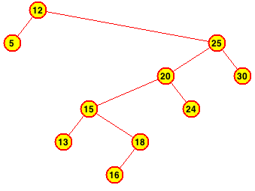
Insert Example
Notes:
Insert 19

Slide 37
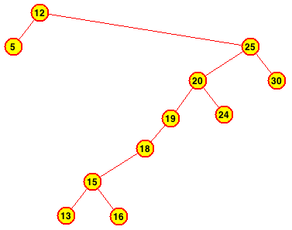
Example Continued

Slide 38
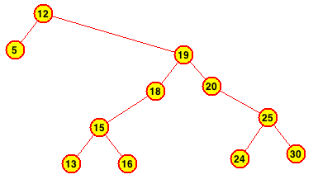
Example Continued

Slide 39
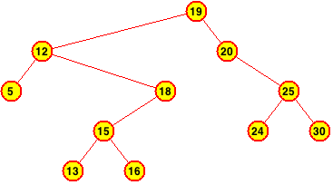
Example Continued

Slide 40
Delete min/max
Delete min
Find min to bring value to the root
Use right child as new root
Delete the min
Delete max
Find max to bring value to the root
Use left child as new root
Delete the max

Slide 41
Delete Max Example
Notes:
Delete 30

Slide 42
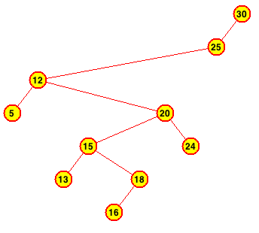
Example Continued

Slide 43
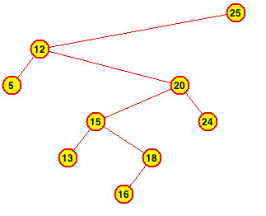
Example Continued

Slide 44
Delete
Find the node, which splays it
Delete root
Left with two subtrees, L and R
Find largest in L using FindMax, this will be the new root
Make R the right child of the new root

Slide 45
Delete Example
Notes:
Delete 15

Slide 46
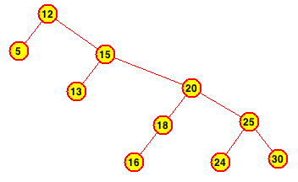
Example Continued

Slide 47
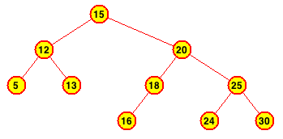
Example Continued

Slide 48
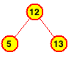
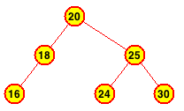
Example Continued

Slide 49
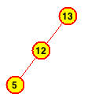
Example Continued

Slide 50
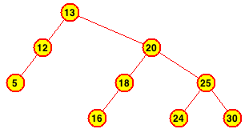
Example Continued

Slide 51
Problems
VERY difficult to implement
Requires a lot of overhead

Slide 52
Top-Down Splay Trees (12.1)
Allows us to splay on the way down
Cuts out overhead
Much easier to implement

Slide 53
The idea
Instead of rotating things out of the way on the way back up, we move them out of the way on the way down
We keep two extra trees, tree L and tree R
Initially empty
As we descend, fill them up

Slide 54
Descend
Two levels at a time, if we can
Get two nodes
If larger than search value, place in tree R
If smaller than search value, place in tree L

Slide 55
Zig

Slide 56
Zig-zig

Slide 57
Zig-zag
Notes:
Wait, we only did one level
This simplifies the code because there aren’t as many cases to consider
Disadvantage: only descended one level, so have to do more iterations of the splay function

Slide 58
Now what?
Am I done?

Slide 59
Now what?
No! I am not done, because now I have 3 trees
I need to reassemble them into one

Slide 60
Reassembly
Notes:
Why don’t we do it the other way around? Why not insert L and R into A and B?
Because L and R are probably going to be shorter

Slide 61
Example
Notes:
Splay c

Slide 62
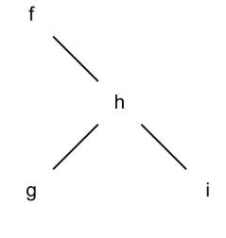
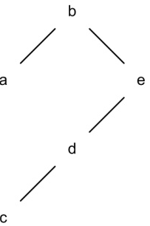
Example Continued

Slide 63
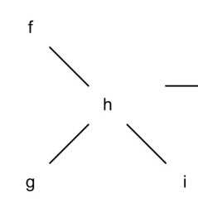
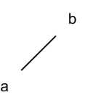
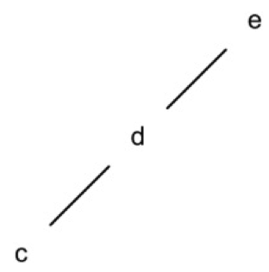
Example Continued

Slide 64
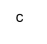
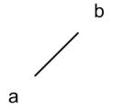
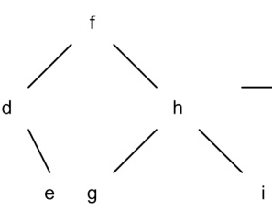
Example Continued

Slide 65
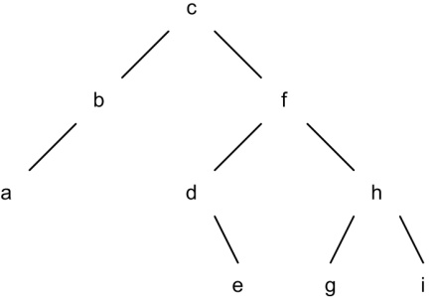
Example Continued

Slide 66
Operations
Find and Delete
Same algorithm, just using a different splay method.
Insert is a little bit different

Slide 67
Insert
Have to splay the value first
Now we have a new root
If root==value, then have a duplicate, don’t insert
If root<value, root becomes value’s left, value becomes root
If root>value, root becomes value’s right, value becomes root

Slide 68
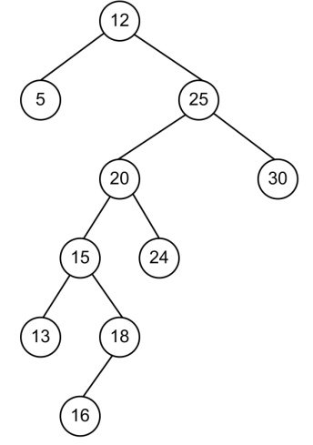
Another Example
Notes:
Splay 18

Slide 69
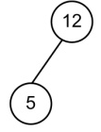
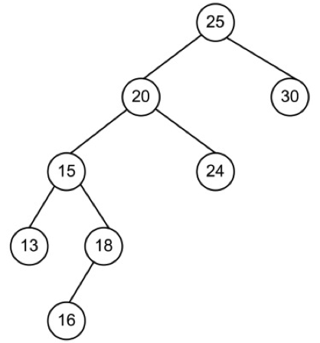
Example Continued

Slide 70
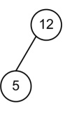
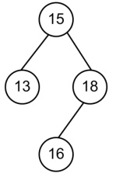
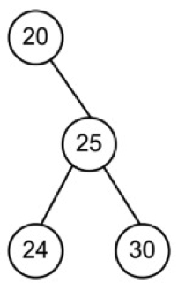
Example Continued

Slide 71
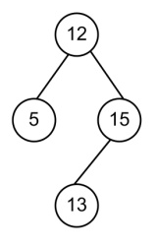
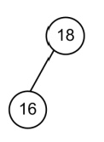
Example Continued

Slide 72
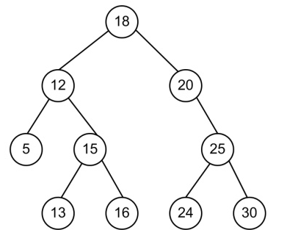
Example Continued

